Slide 1
Adidas Sales Dashboard Report
Interactive Dashboard with Power BI
Javagar.s

Slide 2
Objective
Goal: To design an interactive and insightful sales dashboard using Power BI to track Adidas US performance.
Key Metrics Tracked:
Total Sales
Total Profit
Operating Margin
Units Sold

Slide 3
Dataset Overview
Dataset: Adidas US Sales (2020) Source: Kaggle Fields Used:
Date (Invoice Date)
Location (Region, State, City)
Product Category
Sales Channel (Sales Method)
Financials: Sales, Profit, Margin, Units
Excel Columns:
Retailer
Retailer ID
Invoice Date
Region
State
City
Product
Price per Unit
Units Sold
Total Sales
Operating Profit
Operating Margin
Sales Method

Slide 4
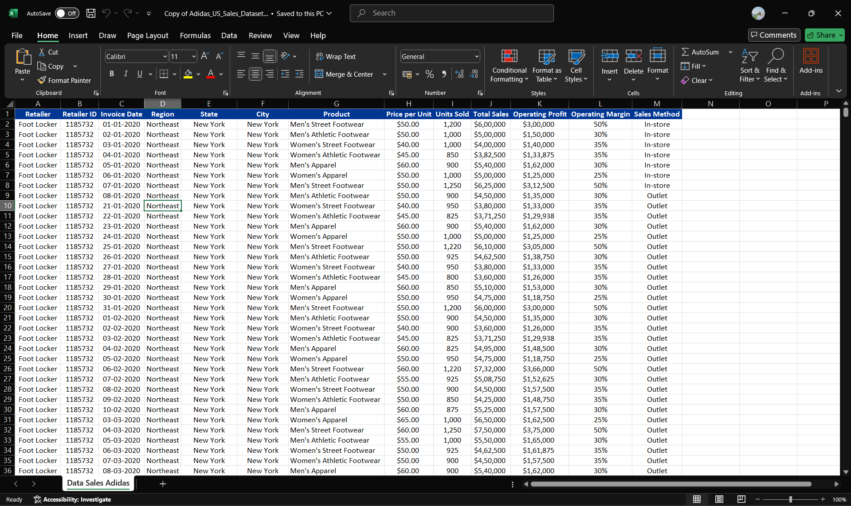
Excel file : Adidas_US_Sales_Datasets

Slide 5
Dashboard KPIs & Visuals
Key KPIs (Cards):
Total Sales
Operating Profit
Avg. Profit Margin
Units Sold
Visuals Used:
Line Chart: Sales Trend Over Time
Bar Chart: Sales by Product
Column Chart: Sales by Region
Donut Chart: Sales by Sales Method
Scatter/Bar: Profit Margin by Product
Slicers: Date, Region, Product, Sales Method

Slide 6
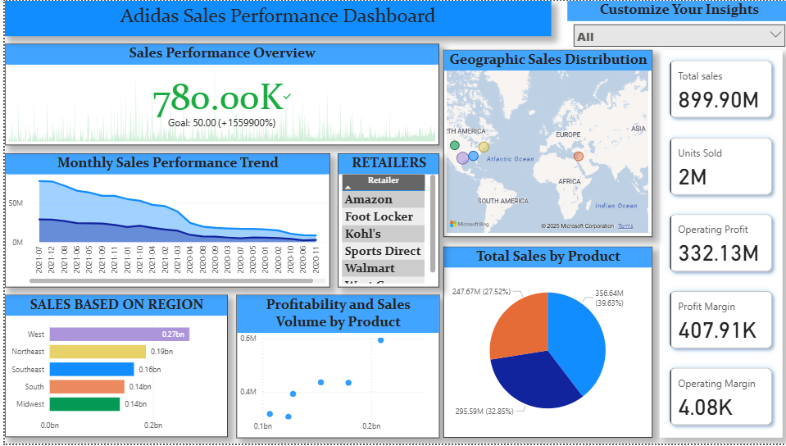
Dashboard for Adidas_US_Sales_Datasets

Slide 7
✅ 1. Best-Selling Product
📈 Men’s Street Footwear is the top-selling product by far:
₹208.8M in total sales
Closely followed by Women’s Apparel and Men’s Athletic Footwear
✅ 2. Top Region
West is the top-performing region, not Northeast:
West: ₹269.9M
Northeast: ₹186.3M ✅ You can update Slide 5 to reflect this correction.
✅ 3. Sales Method Breakdown
Majority of revenue comes from In-store sales:
In-store: ₹356.6M
Outlet: ₹295.6M
Online: ₹247.7M
✅ 4. Profitability by Product
Products with highest average profit margins:
👚 Men’s Street Footwear: 39.65% margin
👗 Women’s Apparel: 38.34%
👟 Women’s Athletic Footwear: 36.55%
🔸 While apparel has strong margins, it has lower unit sales compared to footwear:
Women's Apparel: 433.8K units
Men’s Street Footwear: 593.3K units

Slide 8


